Slide 1
Performance of previous methods on AVNRT data
August 2024
Andrea Corrado

Slide 2
Outline
Recap of problems found so far
Filtering strategy
Spectrum estimation
Alignment strategy
Final questions and conclusion

Slide 3
Recap of problems found
So far, data has been explored to find out their inner characteristics.
Proprieties in time domain
Proprieties in frequency domain
But at least three problems were encountered:
Data require preprocessing
Spectral analysis is hard due to inner limits of methods
Data require alignment
Target 1 : building a population dataset
Target 0: Answer to:
How preprocess data?
How frequency characterise these signals?
How align data?

Slide 4
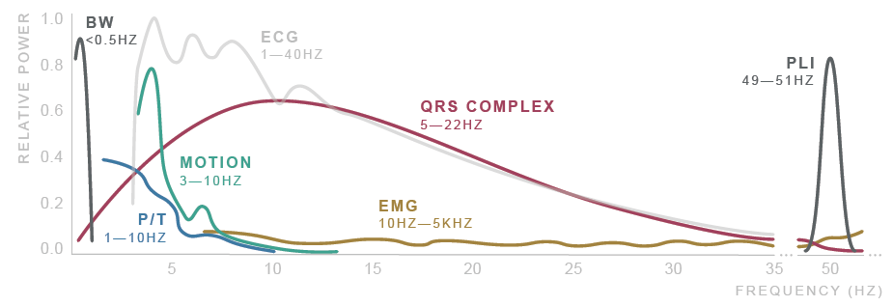
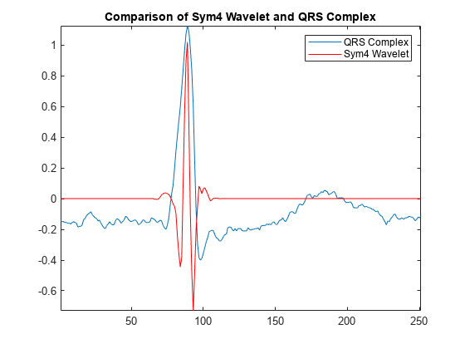
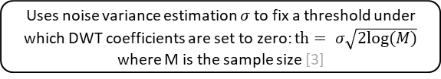
Signal preprocessing
ECG signals noisy and require to be preprocessed and filtered [1]
Noise sources: Physiological, Environmental, Artifacts, Electronic…
After literature research, the proposed filtering method [1,2] consists of:
Donoho thresholding [3] on discrete wavelet transform coefficients (DWT)
Shrink the coefficients related to, presumably, high frequency noise and low frequency noise
Followed by zero-phase band pass filtering
Improves the result eliminating residual noise
Original signal
DWT decomposition
Symlets 4 wavelet is used due to its good performances on ECG signals [2, 3]
Donoho soft thresholding
Uses noise variance estimation $σ$ to fix a threshold under which DWT coefficients are set to zero: $th= σ\sqrt{2log⁡(M)}$ where M is the sample size [3]
DWT reconstruction
Butterworth HP filter (order 6, cutoff at 0.5 Hz)
Butterworth LP filter (order 6, cutoff at 60 Hz)
1. Saraiva, João & Plácido da Silva, Hugo & Fred, Ana. (2022). Denoising and Artifact Removal of the Electrocardiogram, Electrodermal Activity and Accelerometery for Continuous Ambulatory Monitoring of Epileptic Seizures with Wearable Devices.
2. Singh, Brij N., and Arvind K. Tiwari. "Optimal selection of wavelet basis function applied to ECG signal denoising." Digital signal processing 16.3 (2006): 275-287.
3. Donoho, David L. "De-noising by soft-thresholding." IEEE transactions on information theory 41.3 (1995): 613-627.

Slide 5
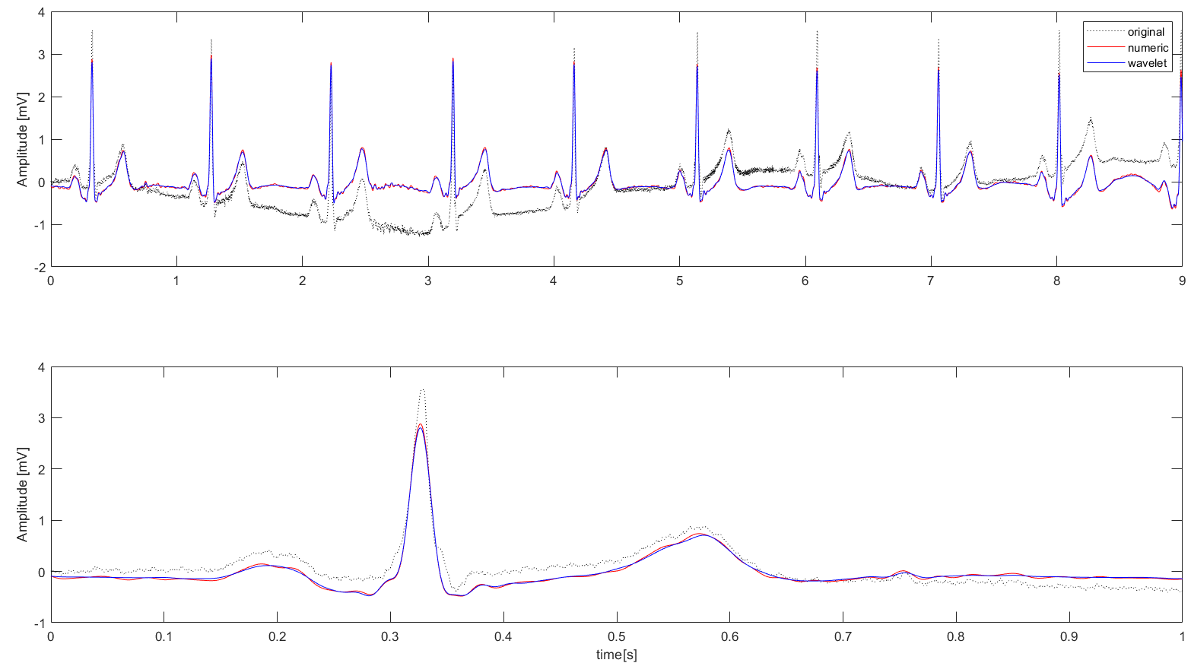
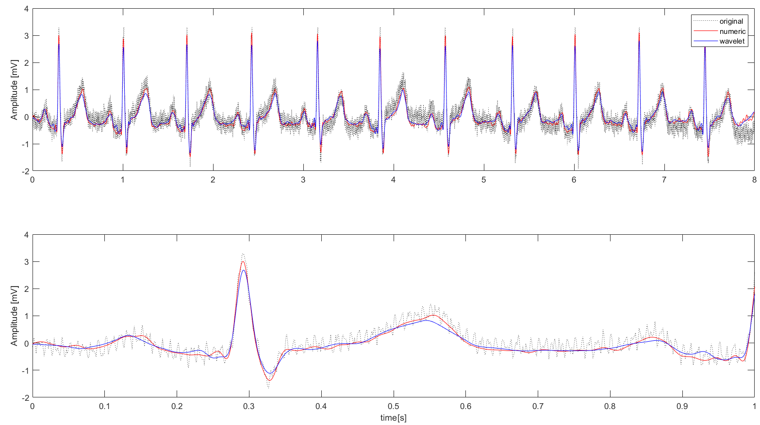
Preprocessing results: External data
The proposed filtering pipeline (blue line) has been tested on well-know external data (didactical) and compared with the same strategy without the DWT thresholding (red line) :
ECG 1: HF noise
ECG 2: LF noise
In conclusion, DWT thresholding combined with BP zero-phase filtering leads to good results.
Moreover, this strategy has other known advantages:
Higher performance even on other sources of noise [1]
Good performances on short signals [1,2]
1. Saraiva, João & Plácido da Silva, Hugo & Fred, Ana. (2022). Denoising and Artifact Removal of the Electrocardiogram, Electrodermal Activity and Accelerometery for Continuous Ambulatory Monitoring of Epileptic Seizures with Wearable Devices.
2. Singh, Brij N., and Arvind K. Tiwari. "Optimal selection of wavelet basis function applied to ECG signal denoising." Digital signal processing 16.3 (2006): 275-287.

Slide 6
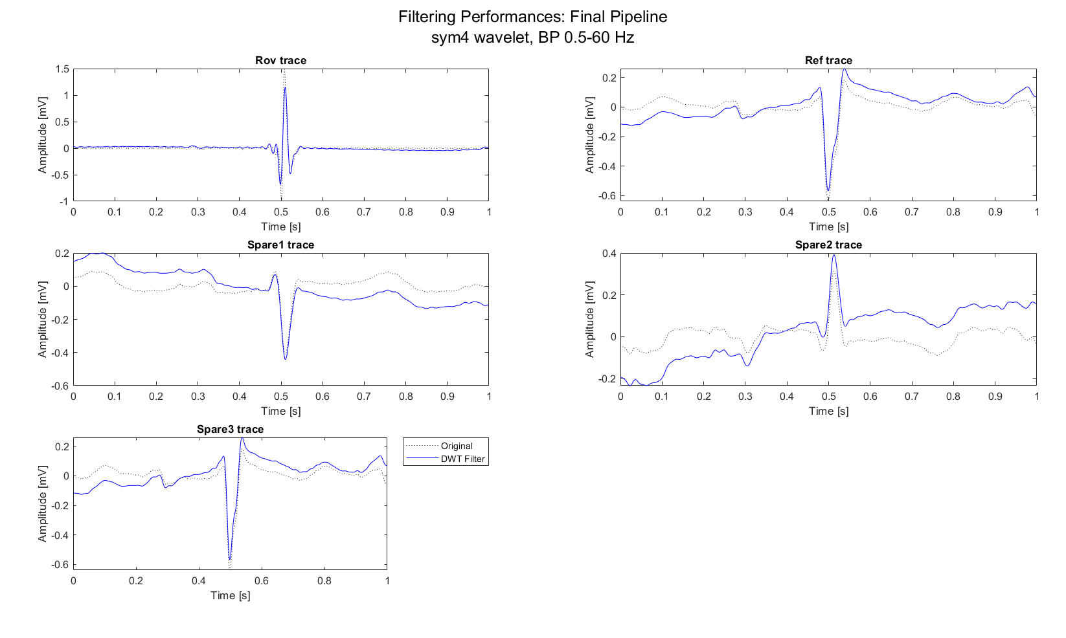
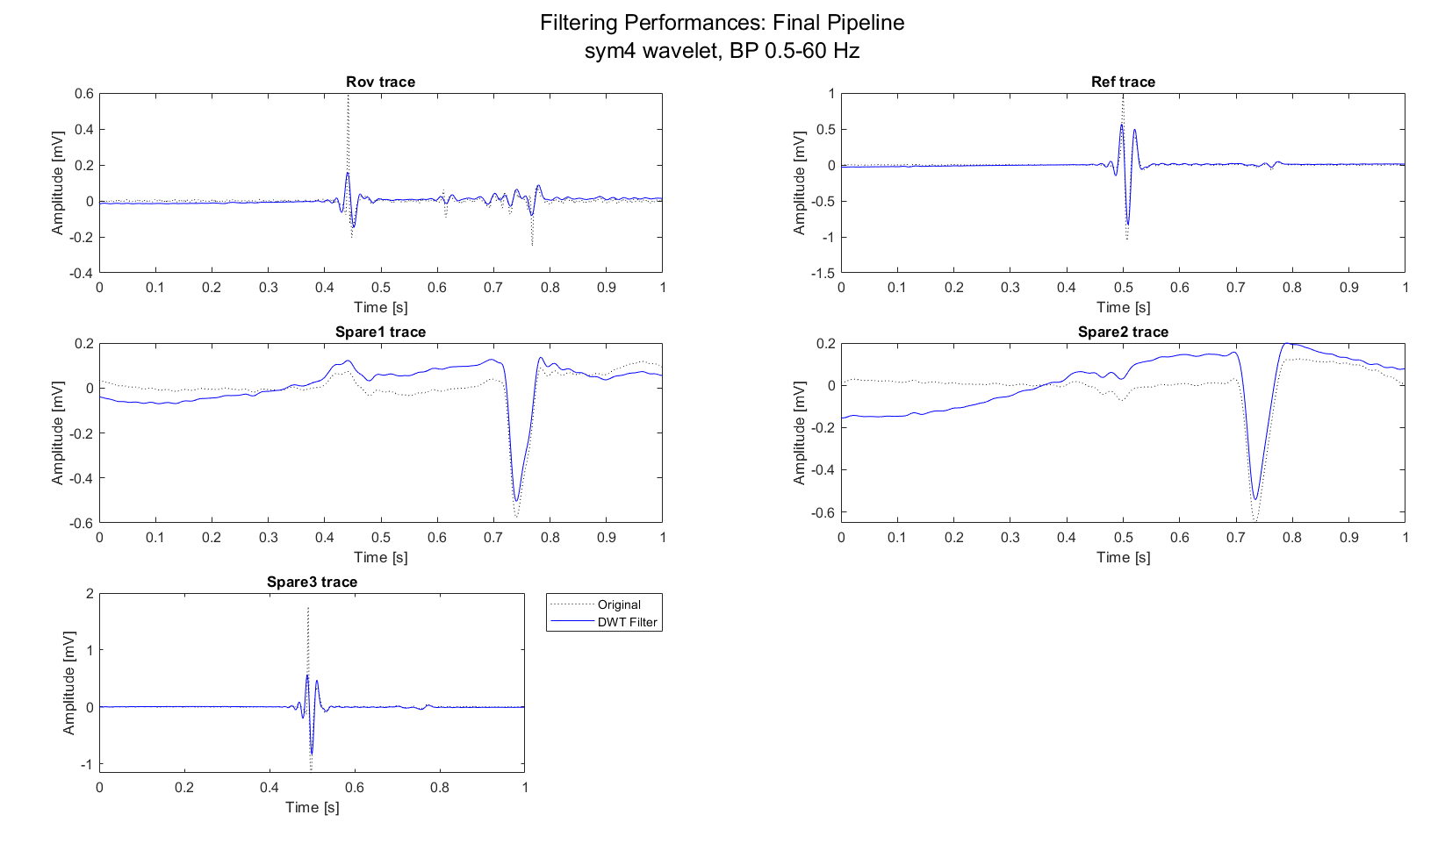
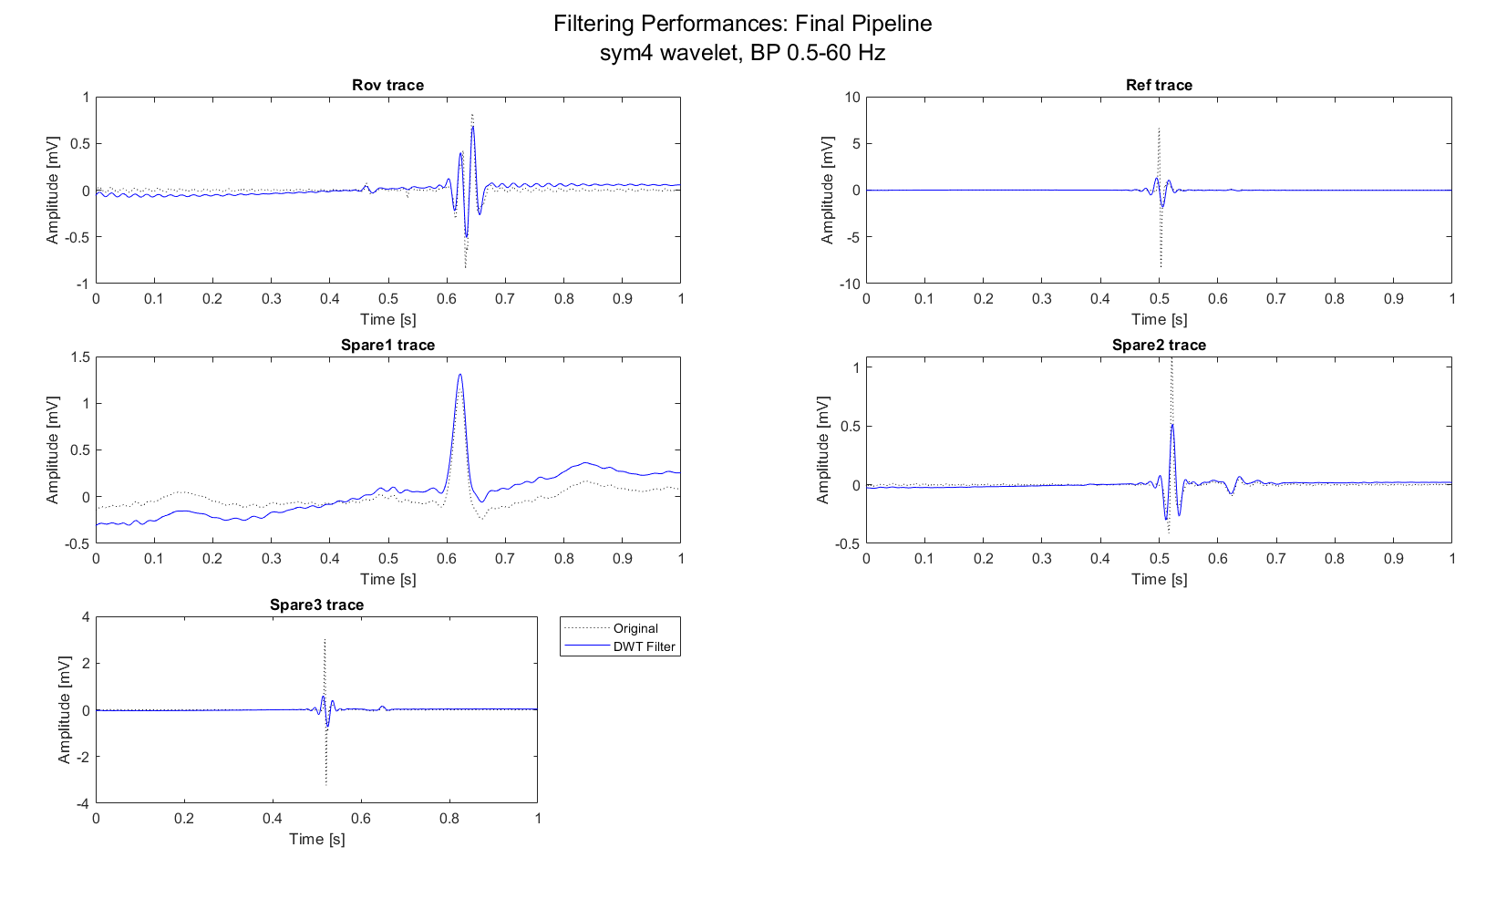
Preprocessing results: AVNRT data
Proposed method ensures the best compromise between noise removal and signal conservation.
MAP C, sub-1, record example
MAP C, sub-7, record example
MAP C, sub-8, record example
Moreover:
Zero-phase ensures the preservation of peaks location
Tail effects mitigation
Important peaks (A-H-V) preserved
Another preprocessing step could be normalizing data (i.e., min-max scaling) to make them comparable.

Slide 7
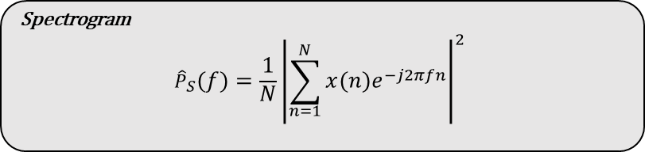
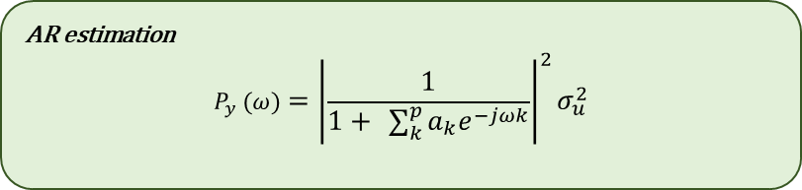
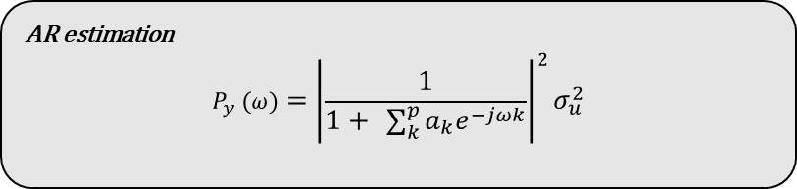
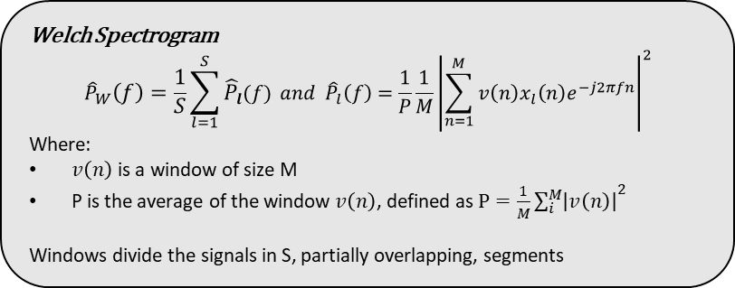
Spectrum estimation
Spectrum estimation can be done following different strategies:
Parametric strategies: i.e., AR estimation
Non-Parametric Strategies: i.e., Spectrogram or Welch estimation
AR spectrum estimation is not so much used in literature, but has important advantages:
Fast and easy application
Consistent and not windowed estimation of the spectrum
And at the same time some attentions:
Require a zero-mean signal as input of the estimator of the model
Order choice is crucial: the model should represent well the signal
Optimal order was found between 8 and 20 in previous studies [4,5]
Spectrum estimation results depends on the AR coefficients estimator [4,5]
LS estimator has the best performance, together with Burg estimation, while Yule-Walker require high order models
AR estimation
$$P_{y} (ω)={\left|\frac{1}{1+ \sum_{k}^{p}{a_{k}e^{−jωk}}}\right|}^{2}σ_{u}^{2}$$
AR estimation
$$P_{y} (ω)={\left|\frac{1}{1+ \sum_{k}^{p}{a_{k}e^{−jωk}}}\right|}^{2}σ_{u}^{2}$$
Spectrogram
$${\hat{P}}_{S}\left(f\right)=\frac{1}{N}{\left|\sum_{n=1}^{N}{x\left(n\right)e^{−j2πfn}}\right|}^{2}$$
DWT thresholding and BP filter
AR order estimation using nAIC criterion
AR spectrum estimation using LS estimator
Signal
Welch Spectrogram
$${\hat{P}}_{W}\left(f\right)=\frac{1}{S}\sum_{l=1}^{S}{{\hat{P}}_{l}(f)} and {\hat{P}}_{l}\left(f\right)=\frac{1}{P}\frac{1}{M}{\left|\sum_{n=1}^{M}{v\left(n\right)x_{l}\left(n\right)e^{−j2πfn}}\right|}^{2}$$
Where:
$v\left(n\right)$ is a window of size M
P is the average of the window $v\left(n\right)$, defined as $P=\frac{1}{M}{\sum_{i}^{M}{\left|v\left(n\right)\right|}}^{2}$
Windows divide the signals in S, partially overlapping, segments
4. Übeyli, Elif Derya, Dean Cvetkovic, and Irena Cosic. "AR spectral analysis technique for human PPG, ECG and EEG signals." Journal of Medical Systems 32 (2008): 201-206.
5. Nayak, Jagadish, et al. "AR modeling of heart rate signals." 2004 IEEE Region 10 Conference TENCON 2004.. IEEE, 2004.

Slide 8
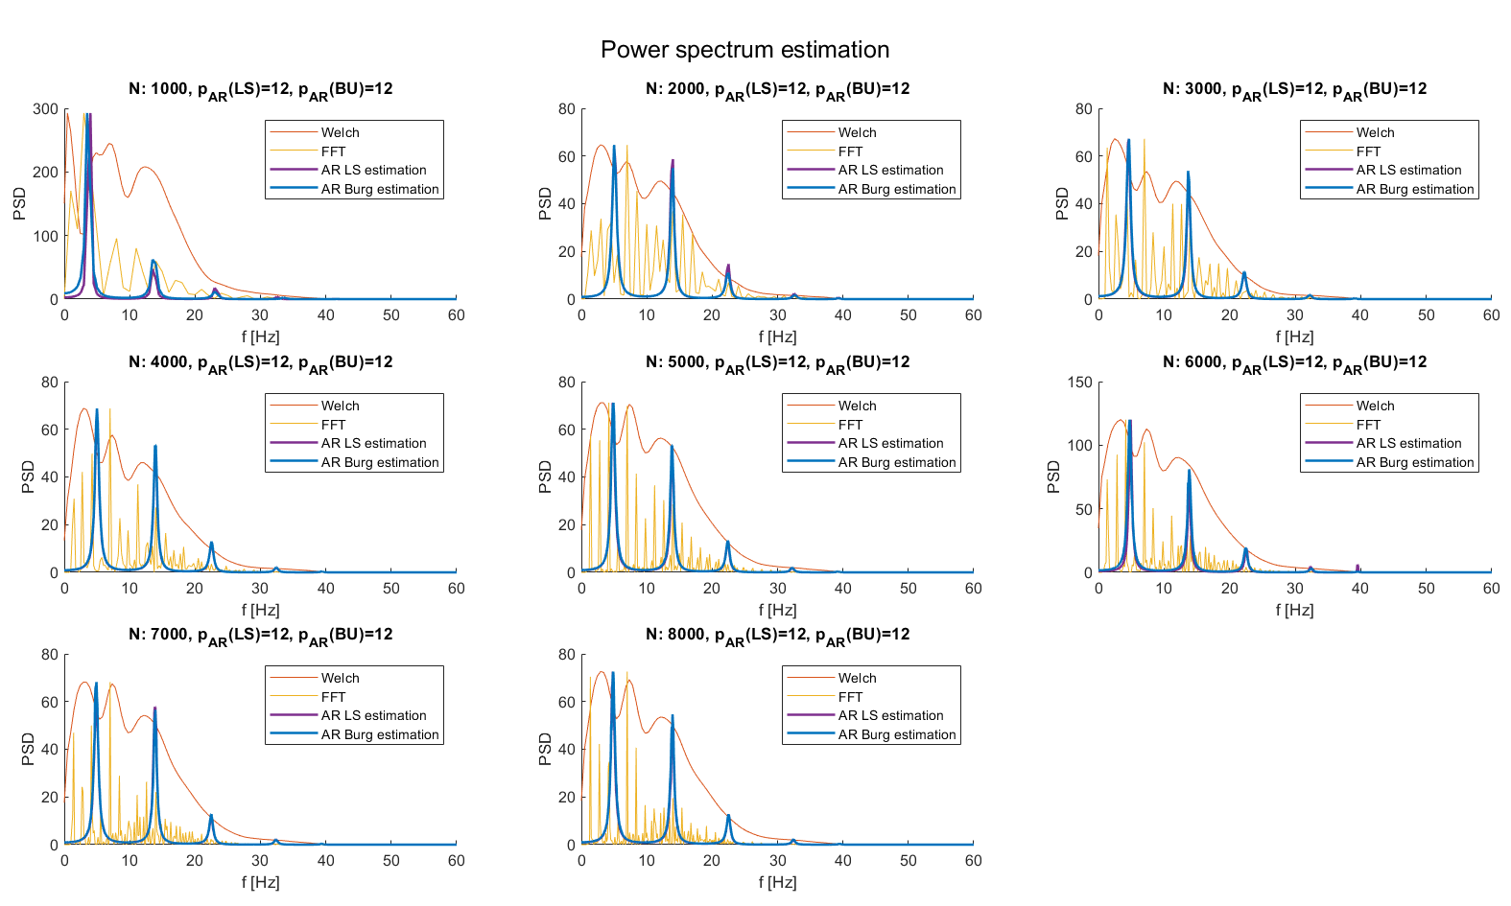
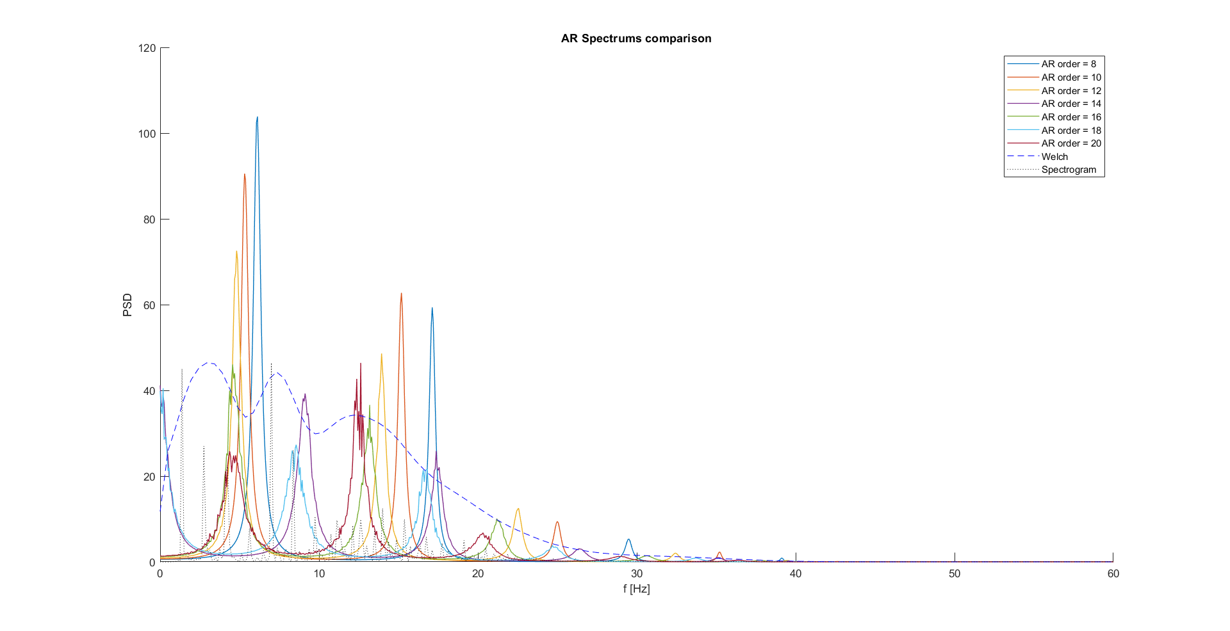
Spectrum estimation results: External data
The proposed spectrum estimation pipeline has been tested on well-know external data (didactical) and compared with the more used Spectrogram and Welch spectrogram.
Each subplot correspond to a spectrum evaluation of a HF noise corrupted signal with an increased number of points (i.e., beats) filtered with the proposed pipeline.
Burg and LS estimators converge
AR estimation seems to underestimate the signal, thus AR spectrum peaks are not aligned with the Welch ones.
Moreover, by changing the order, AR spectrum peaks moves, leading to the conclusion that AR spectral estimation does not provide satisfactory results.
LS estimation
1. Saraiva, João & Plácido da Silva, Hugo & Fred, Ana. (2022). Denoising and Artifact Removal of the Electrocardiogram, Electrodermal Activity and Accelerometery for Continuous Ambulatory Monitoring of Epileptic Seizures with Wearable Devices.
2. Singh, Brij N., and Arvind K. Tiwari. "Optimal selection of wavelet basis function applied to ECG signal denoising." Digital signal processing 16.3 (2006): 275-287.

Slide 9
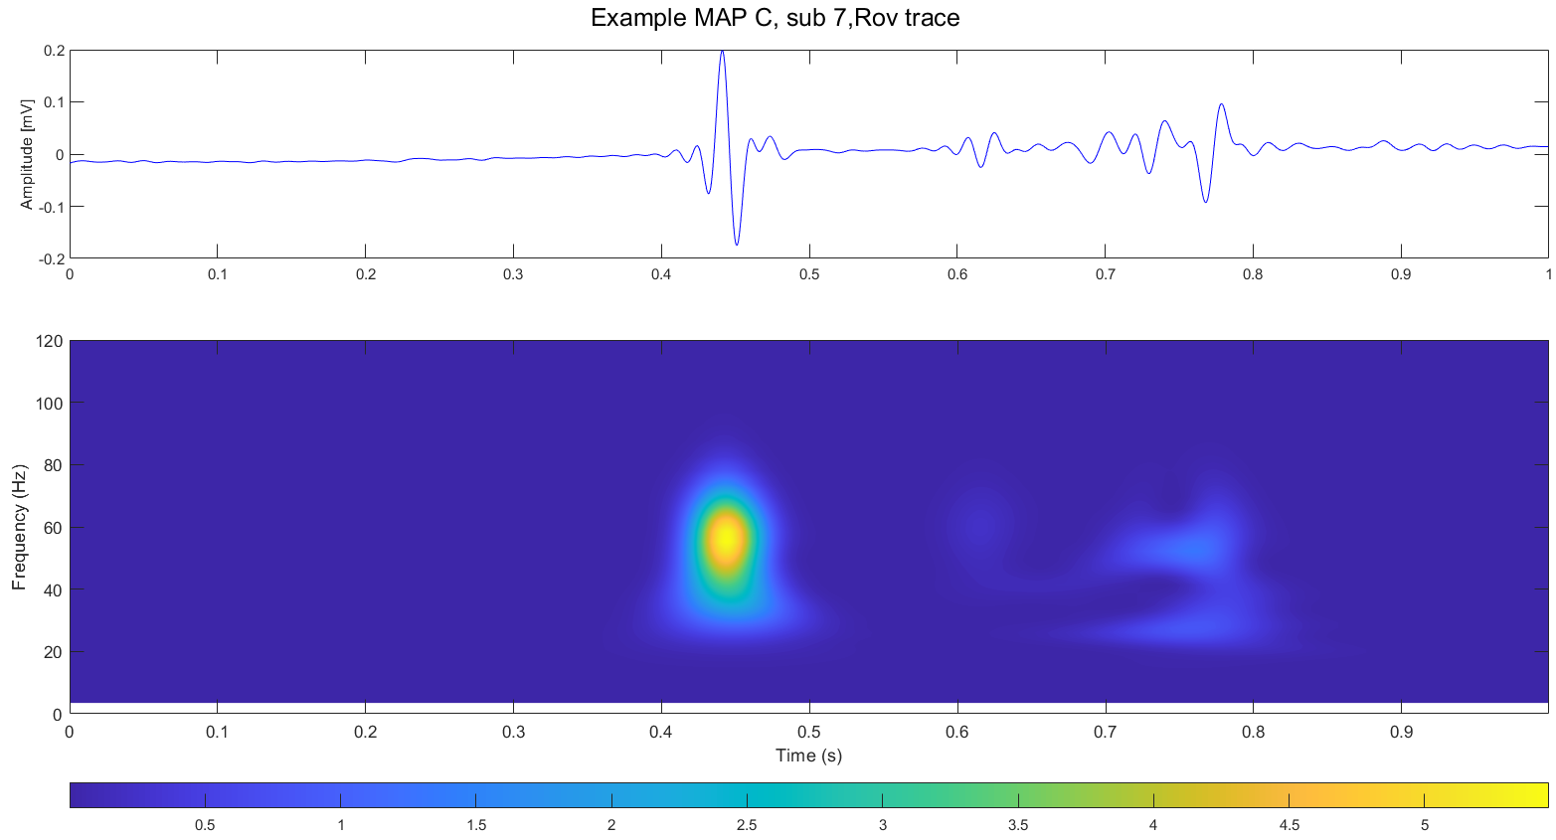
Spectrum estimation results: AVNRT data
Now a dilemma arises:
On one hand, is known that spectral estimation could leave important insights on the data characteristics
On the other hand, AR spectrum estimation doesn’t improve results of Spectrogram and Welch Spectrogram
Moreover, Welch spectrogram still has the problems of non-parametric spectrum estimation
So, are there other methods that can be used?
Many studies use DWT features as descriptors of the frequency behavior of ECG signals REFERENCE
Other uses even 2-D representations of DWT, i.e., scalograms
Atrial
Ventricular
His’ bundle

Slide 10
Alignment necessity
Alignment was found to be necessary …

Slide 11
Alignment results
Alignment was found to be necessary …

Slide 12
Conclusions
Previously studied methods leads to encouraging results:
Mixed strategy of filtering: with minor differences respect to the original pipeline, the performance are satisfactory.
Spectrum evaluation pipeline: results on single beat comparable with didactical examples and good frequency resolution overall. It’s possible that further steps will require data rescaling.
Moreover, the possibility of using scalogram as time-frequency representations of AVNRT signals it has been explored. First results in this way are encouraging, with observable differences between maps, but more analysis should be done, even with data rescaling.
Next steps could be, in order:
Building population dataset
Remaking population analysis
Deciding a pool of features to use on AVNRT data
Extract features from AVNRT data
Starting developing a ML model

Slide 13
References
J. Bialasiewicz, "Application of Wavelet Scalogram and Coscalogram for Analysis of Biomedical Signals," Proceedings of the Conference, July 2015.
Daydulo, Y.D., Thamineni, B.L. & Dawud, A.A. Cardiac arrhythmia detection using deep learning approach and time frequency representation of ECG signals. BMC Med Inform Decis Mak 23, 232 (2023).
S. C. Olhede and A. T. Walden, "Generalized Morse wavelets," in IEEE Transactions on Signal Processing, vol. 50, no. 11, pp. 2661-2670, Nov. 2002, doi: 10.1109/TSP.2002.804066.

